Slide 1
Kernel SVM : Linear / Polynomial / Radial
Jithin J Kumar

Slide 2
SVM ?
A Support Vector Machine (SVM) is a supervised machine learning algorithm that can be employed for both classification and regression purposes. SVMs are more commonly used in classification problems.
SVMs are based on the idea of finding a hyperplane that best divides a dataset

Slide 3
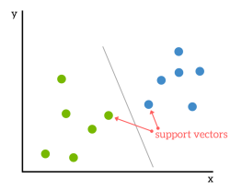
Support Vectors
Support vectors are the data points nearest to the hyperplane, the points of a data set that, if removed, would alter the position of the dividing hyperplane. Because of this, they can be considered the critical elements of a data set.

Slide 4
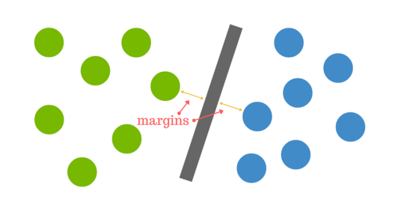
How do we find the right hyperplane?
The distance between the hyperplane and the nearest data point from either set is known as the margin. The goal is to choose a hyperplane with the greatest possible margin between the hyperplane and any point within the training set, giving a greater chance of new data being classified correctly.

Slide 5
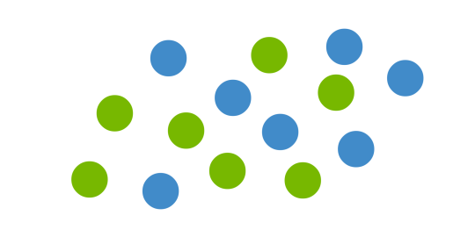
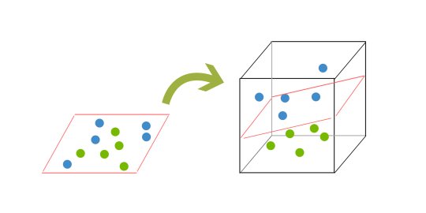
But what if there is no clear hyperplane?
In order to classify a dataset like the one above it’s necessary to move away from a 2d view of the data to a 3d view.
This ‘lifting’ of the balls represents the mapping of data into a higher dimension. This is known as kernelling

Slide 6
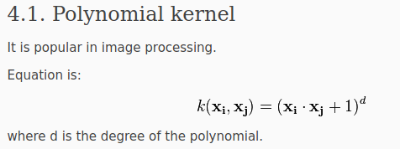
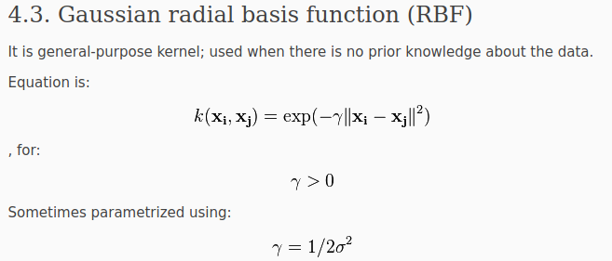
Kernel Functions.
The function of kernel is to take data as input and transform it into the required form. Different SVM algorithms use different types of kernel functions. These functions can be different types. For example linear, nonlinear, polynomial, radial basis function (RBF), and sigmoid.

Slide 7
Applications of SVM
Face detection – SVMc classify parts of the image as a face and non-face and create a square boundary around the face.
Text and hypertext categorization – SVMs allow Text and hyper text categorization for both inductive and transductive models. They use training data to classify documents into different categories. It categorizes on the basis of the score generated and then compares with the threshold value.
Classification of images – Use of SVMs provides better search accuracy for image classification. It provides better accuracy in comparison to the traditional query based searching techniques.
Bioinformatics – It includes protein classification and cancer classification. We use SVM for identifying the classification of genes, patients on the basis of genes and other biological problems.
Protein fold and remote homology detection – Apply SVM algorithms for protein remote homology detection.
Handwriting recognition – We use SVMs to recognize hand written characters used widely.
Generalized predictive control(GPC) – Use SVM based GPC to control chaotic dynamics with useful parameters

